Slide 1
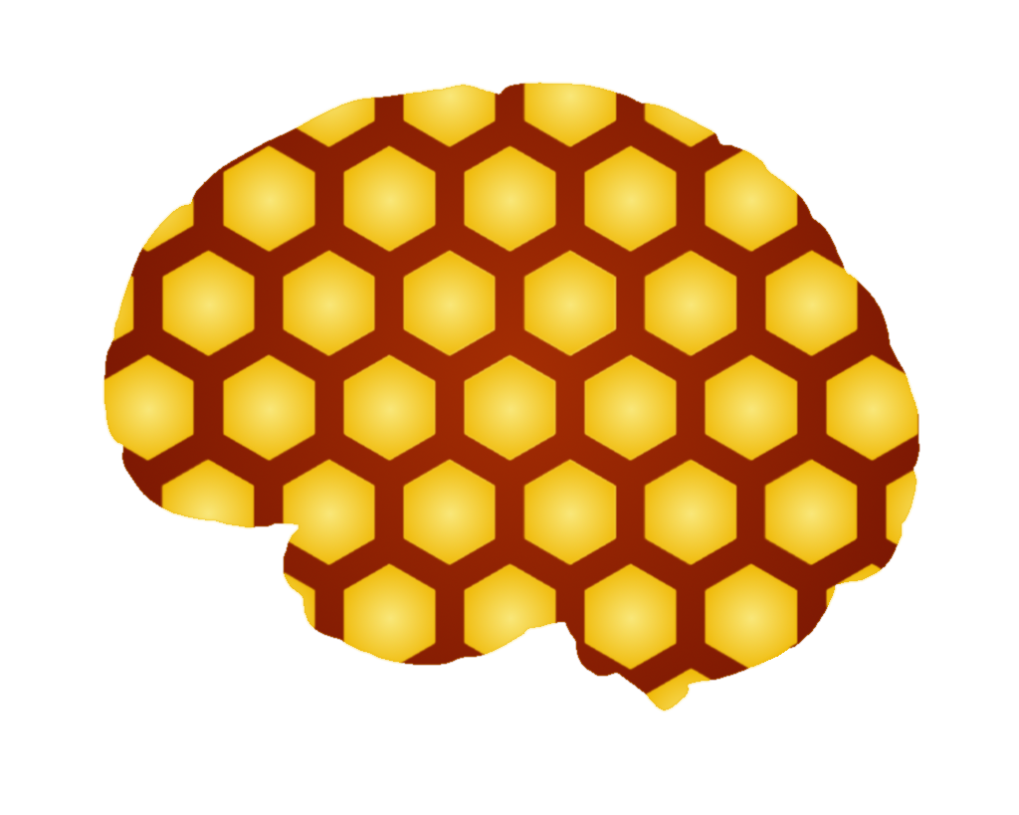
Memcomb
Noah Bradley, Bryce Waters, Isaac Watson, Jizhou Zhang, Andrew Dever, Kyle King

Slide 2
Memcomb
For those who want to share and connect through similar memories in their lives. The Memcomb application is a social media platform that allows users to upload photos, videos, and audio, with an attached caption, that displays an important event in their lives. Unlike similar applications, Memcomb will connect users who share events of a similar time and place, allowing those users to discover each other. Our product provides a new way for users to interact with one another.
Noah

Slide 3
This Sprint
Creating our first memory
Uploading and Previewing one or more images
Storing that information on the DB
Creating development and staging environments
Done research on Unit Testings and begin automated testing for each of the files
Defined ‘connection’ in the context of our project, as well as its parameters
Designed user management practices
Noah

Slide 4
Challenges and Risks
Previewing memory fragments before connecting them to DB
Learning how unit testing should interact with the other pages
Pipeline web server hosting on IIS
Allowing the user to upload multiple images
Will explain more in the demo
Bryce

Slide 5
Mitigation Plan
Research into HTML DIV duplication
Will show in demo
Research on the concepts of unit testing and unit testing tutorials
Use of AJAX
Injects the data into database
Bryce

Slide 6
What is a Connection?
Connections are the second part of our website’s functionality
When two users upload a fragment that has the same location and date, a connection is created. Both users are notified of the connection, and are notified of this. The connections are private between the users and gives them the option to message each other, as well as follow each other
These connections can happen between any two users, even if they aren't following each other
Kyle

Slide 7
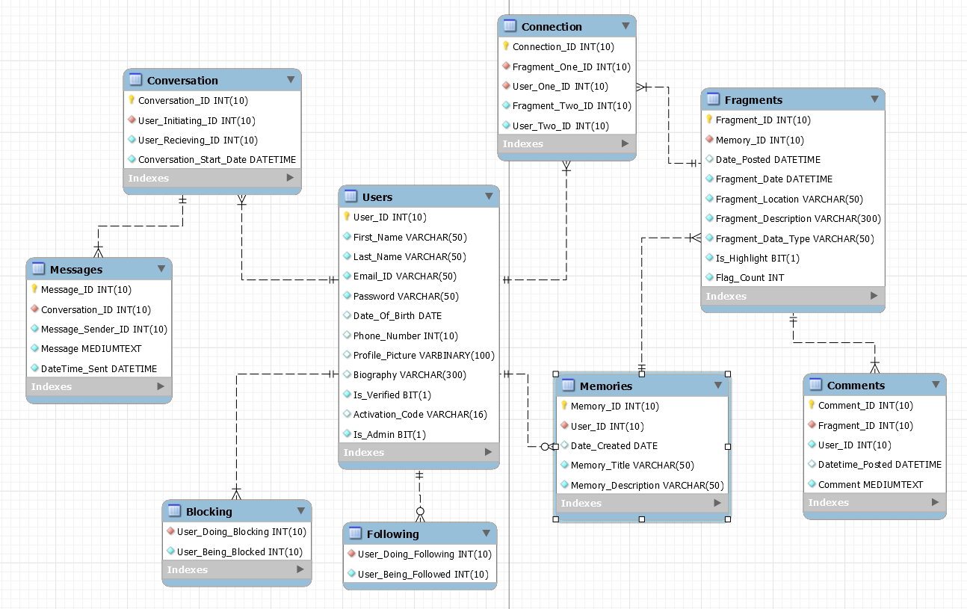
Current EERD

Slide 8
User Stories
This Sprint
As a user I want to be able to upload a memory
Multiple Fragments, including unique locations, dates, and captions
As a developer, I need different environments for testing and staging
Next Sprint
As a user I need to be able to view memories uploaded by my friends
Create connections between those who are not yet friends
Jizhou

Slide 9
Next Sprint Objectives
Allow users to follow other users
Allow users to see memories made by users they follow
Begin developing connections between those with similar memories, who are also not yet being followed
Fix the HTML / CSS for the modal on the homepage
Continue Automated Testing
Security
Andrew

Slide 10
Demo

